Slide 1

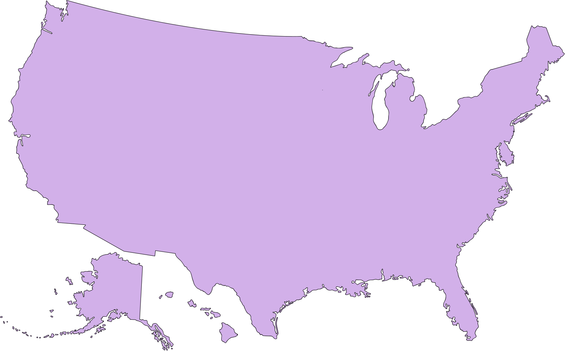
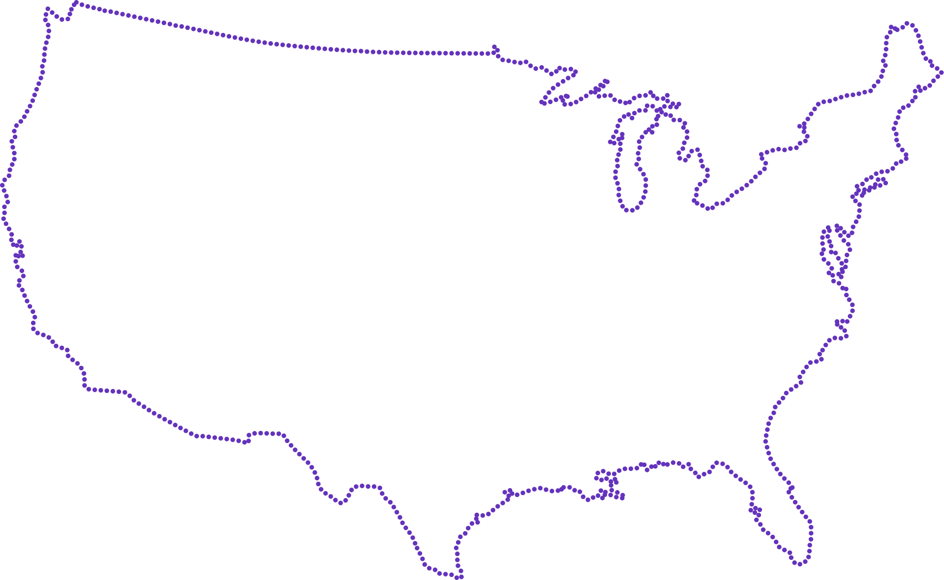
Data-Driven Insights on U.S. Labor Market & Unemployment Trends
An in-depth exploration of workforce trends, employment shifts, and state-level unemployment insights

Slide 2


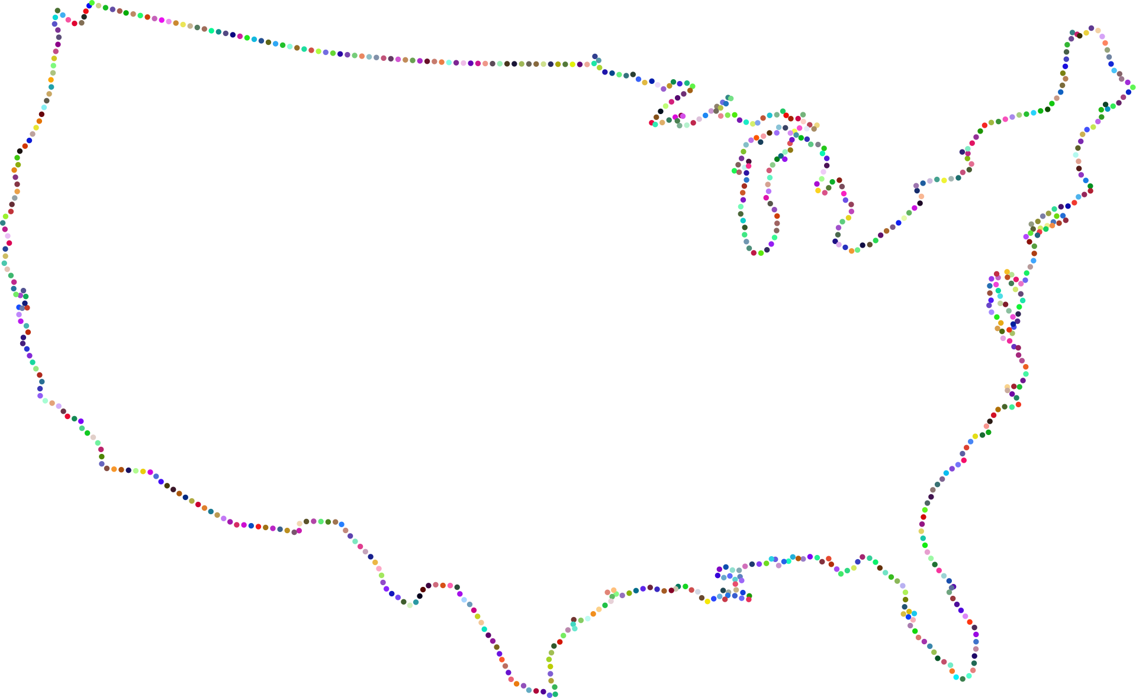
MEAT OUR TEAM MEMBERS
ONE TEAM. ONE VISION. ONE DASHBOARD
Each member brought a unique strength, and together we built a powerful analytical story behind the numbers.
United by purpose, we aligned our roles to design a clear, accurate, and impactful visualization of unemployment in the U.S.

Slide 3






“The creative engine unique ideas, bold colors, and out of the box thinking.”
“The problem solver nothing is too complex for him to crack”
“The hard worker always pushing, learning, and delivering like a real business pro”
BASMALA HELMY
KHALED RABBAH
MARYEM MOHAMED
Data Analyst
Data scientist
Data Analyst
“Innovative mind with sharp problem
solving and ideas that always elevate the work”
“Our design mastermind the one who turns dashboards into art”
“Hard
working, committed, and always trying something new”
MUSTAFA ADEL
HABIBA AMR
OLIVER MEDHAT
Data Analyst
Data Analyst
Data Analyst

Slide 4
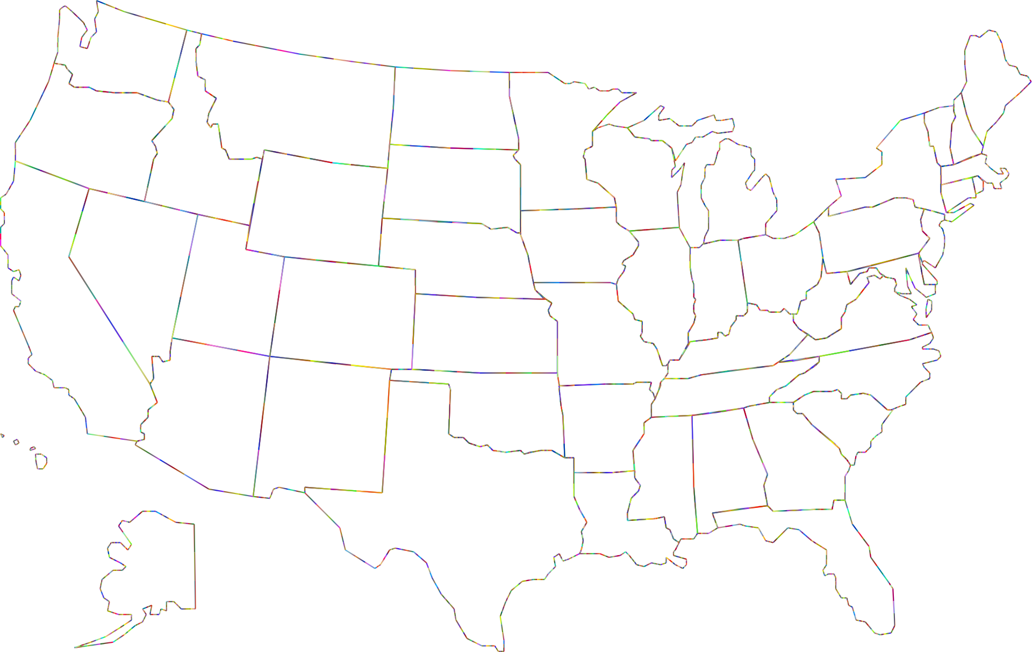
INTRODUCTION TO OUR PROJECT IDEA
“Beyond Jobless” is an idea of exploring the employment landscape across all U.S. states. It examines monthly unemployment rates since 1976. The goal is to understand how different factors shape the American job market and what drives people in or out of work.

Slide 5
HOW THE IDEA STARTED
We wanted to explore a topic that affects both individuals and the economy. After reviewing several datasets, we noticed how rich and detailed U.S. labor statistics are, where it covers employment history, incomes, and hiring behavior. This inspired us to create a full picture of what the job market really looks like and how it has changed over time.

Slide 6
WHY
“BEYOND JOBLESS”
1
2
3
4
THE TOPIC ALLOWS DEEP ANALYSIS AND IMPACTFUL VISUALIZATIONS.
THE U.S. PROVIDES RELIABLE AND HISTORIC DATA (BACK TO 1976).
THE JOB MARKET IS ONE OF THE STRONGEST INDICATORS OF ECONOMIC STABILITY.
DIFFERENT JOB FIELDS SHOW CONTRASTS IN PAY, DEMAND, AND STABILITY.

Slide 7

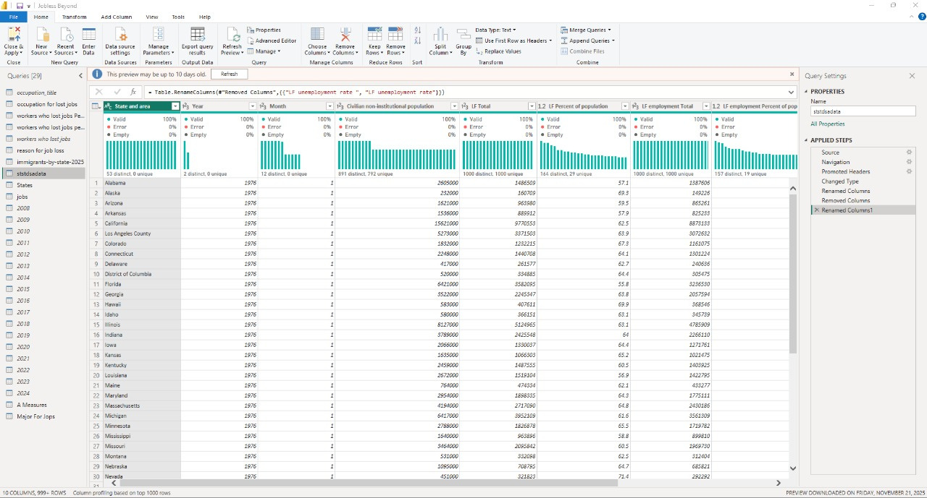

DATA MINING
& CLEANING
IN THIS PART WE SAILED ACROSS THE VAST OCEAN OF U.S. EMPLOYMENT DATA, NAVIGATING THOUSANDS OF RECORDS & EXPLORING EVERY CORNER TO UNCOVER THE INSIGHTS WE NEEDED FOR OUR PROJECT.

Slide 8
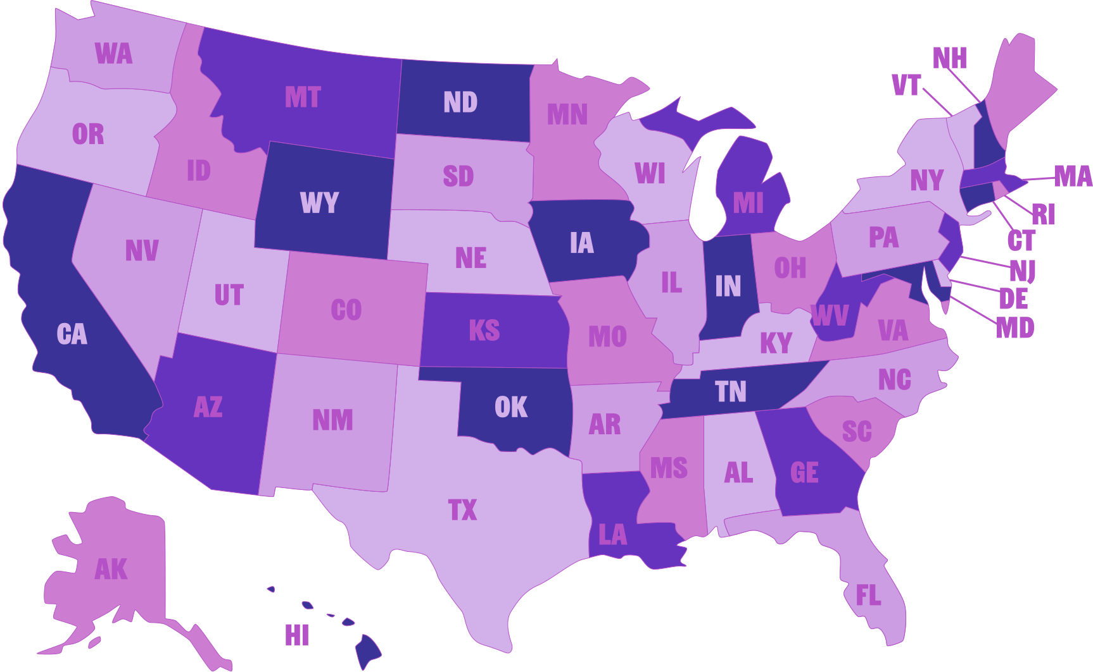
“DURING THE CLEANING PHASE, WE APPLIED COMMON STEPS TO ALL TABLES & DATA SETS, WHERE WE:
1| REMOVED ALL DUPLICATED VALUES,
2| RENAMED ALL COLUMNS TO CLEAR & READABLE NAMES,
3| IDENTIFIED MISSING VALUES & INCONSISTENCIES,
4| CATEGORIZED MAJOR DATA CATEGORIES INTO SEPERATED TABLES
WE USED THE M LANGUAGE AND POWERQUERY TO CLEAN 15 MILLION ROW.”

Slide 9
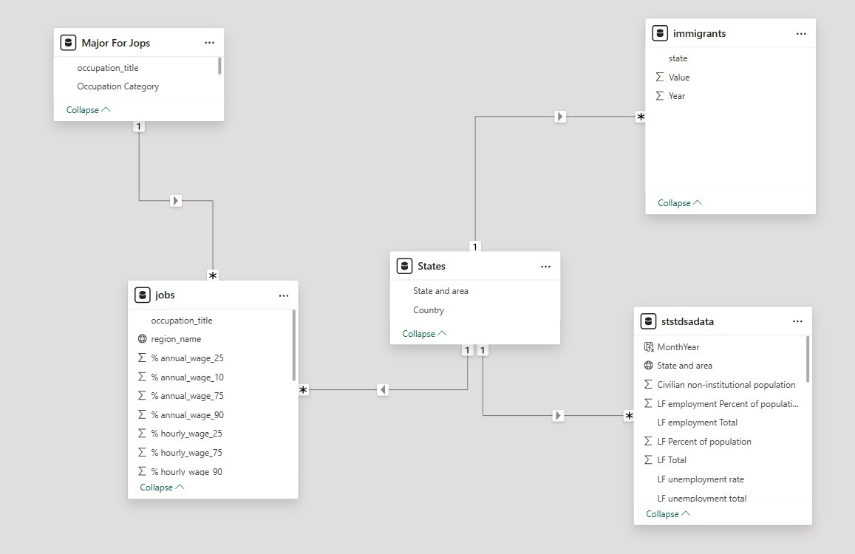
DATA STRUCTURING& MODELING
ONCE THE DATA WAS CLEANED, WE MOVED INTO STRUCTURING AND MODELING WHERE WE STARTED REFORMMING OUR CLEANED DATASETS TO SUPPORT OUR ANALYTICAL VISION BY APPLYING STRATEGIC DAX MEASURES & FUNCTIONS, AND BUILDING RELATIONSHIPS BETWEEN QUERIES.
TWO KEY DAX FUNCTIONS PLAYED A MAJOR ROLE IN SHAPING THE DEPTH AND INTELLIGENCE OF OUR ANALYSIS, AND WE WILL HIGHLIGHT THEM IN THE UPCOMING SLIDES.

Slide 10
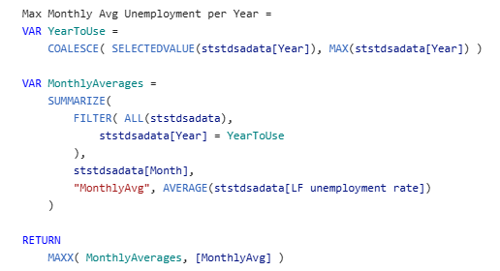
DAX MEASURE “1”
We needed a way to pinpoint the month with the highest unemployment rate in each year for every state, to identify unusual spikes caused by economic crises (ex: Covid 19).
This measure identifies which specific year is being analyzed and then focuses only on that year’s data, and sates the highest monthly unemployment rate of the year.

Slide 11
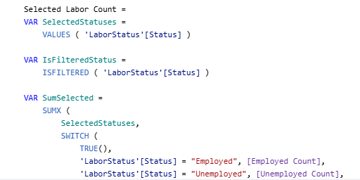
DAX Measure “2”

Slide 12
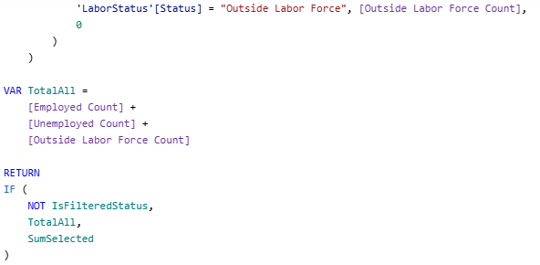
DAX Measure “2”
This measure adapts its calculation based on the user’s selection of labor categories. If no status is selected, it returns the total number of people across: employed, unemployed, and outside the labor force. When the user selects specific statuses, the measure only sums the counts for those chosen categories. This allows the dashboard to respond intelligently to filters and show exactly the labor count the user wants to analyze.

Slide 13


Data
Resources
All Labor Force Statistics | All Labor Force Statistics
Accuracy Data Checking | Accuracy Data Checking
Here you can find the resources from where we collected tha main data sets we worked on for this project:

Slide 14


DEPI
THANK YOU FOR YOUR ATTENTION

